Slide 1

Azure Cache for Redis

Slide 2
What is Redis
Remote Dictionary Server (Redis) is an in-memory data structure mainly used for Caching, and disk is used for persistence.
Written in C
Single threaded
Uses RESP (REdis Serialization Protocol) over TCP to communicate typically on port 6379.
Introduced in 2009 by Salvatore Sanfilippo and currently maintained by Redis Labs

Slide 3
Redis Databases
A single Redis instance consists of max 16 logical databases. With indices 0-15 (db0-db15)
By default, new connections use db0
If using any other database other than default db0 then client must specify it in connection string.
We can leverage multiple databases for different environments like Dev, Test, Staging, Production, etc.

Slide 4
We can switch between databases by using SELECT command.
We can’t switch databases if Redis operates in cluster mode.
To delete all the keys (synchronously/asynchronously) in the selected database we use FLUSHDB command.
FLUSHDB [sync|async]
To delete all the keys (synchronously/asynchronously) in all 16 databases we use FLUSHALL command.
FLUSHALL [sync|async]

Slide 5
Redis Data Types
Strings
Lists
Hashes
Sets
Sorted Sets
HyperLogsLogs

Slide 6
Strings
Binary safe strings which can hold up to 512 Megabytes data.
To set a simple string value with optional expiry:
SET <key> <value> <expiry>
// Set some key with some value with 30 seconds TTL
e.g: SET somekey somevalue EX 30
To set multiple simple string values in one go:
MSET <key1> <value1> <key2> <value2> … <keyN> <valueN>

Slide 7
To append string into an existing string we can use the APPEND command.
APPEND <key> <value>
E.g: > APPEND somekey hello
> APPEND somekey world
To get a string value we can use GET command.
GET <key>
E.g: GET somekey
To get multiple string value we can use MGET command
MGET <key1> <key2> …
E.g: MGET somekey somekey2
To check a string exists or not, we can use EXISTS command
EXISTS <key>

Slide 8
We can increment a key by 1 or some other number, increments are always atomic.
INCR <key> // Increment by 1
INCRBY <key> <value> // Increment by value
Same we can decrement a key by 1 or some other number, decrements are always atomic.
DECR <key> // Decrement by 1
DECRBY <key> <value> // Decrement by value

Slide 9
Lists
Collection of strings sorted by inserted order with maximum capacity of 2^32 – 1 (~4.2 billion items).
Redis lists are implemented as linked lists in C.
To add items at head (left) we use LPUSH command.
LPUSH <listname> <value1> <value2> … <valueN>
E.g: > LPUSH mylist 72
To add items at tail (right) we use RPUSH command.
RPUSH <listname> <value1> <value2> … <valueN>
E.g: > RPUSH mylist 80

Slide 10
To iterate through the list from head to tail (left to right) we can use LRANGE command.
LRANGE <start_offset> <end_offset>
E.g: LRANGE 0 -1 // -1 as end offset denotes the end of the list
To get the number of items in a list we use LLEN command.
LLEN <listname>
E.g: LLEN mylist
To get the items by index we can use the LINDEX command.
LINDEX <listname> <zero_based_index>
E.g: LINDEX mylist 0 // Get list item at index 0
LINDEX mylist -1 // Get last list item

Slide 11
To remove items from near head given start and stop indices we can use the LTRIM command.
LTRIM <list_name> <start> <stop>
E.g: LTRIM mylist 0 4 // Trim first 4 elements from near head
To remove 1 item of the list from near the head (left) we use LPOP command.
LPOP <list_name>
E.g: LPOP mylist
To remove 1 item of the list from near the tail (right) we use RPOP command.
RPOP <list_name>
E.g: RPOP mylist

Slide 12
Hashes
Hashes are associative objects which serves as maps between keys and values. (Like C# dictionary/Java HashMap).
To set values into a hash we use the HSET command.
HSET <outer_key> <key1> <value1> <key2> <value2> …
E.g: HSET user:3 first John last Doe age 30
To get a specific value from a hash we use HGET command.
HGET <outer_key> <key>
E.g: HGET user:3 age // Get the age key

Slide 13
To get all keys in a hash we use HGETALL command.
HGETALL <outer_key>
E.g: HGETALL user:3
To delete a key from the hash we use the HDEL command.
HDEL <outer_key> <key>
E.g: HDEL user:3 age
To increment a value in the hash we use the HINCRBY command.
HINCRBY <outer_key> <key> <increment_value>
E.g: HINCRBY user:3 age 5

Slide 14
Sets
Sets are unordered collection of strings which always have unique members. (Like C# / Java HashSet collection).
We can also do mathematical set operations like union and intersection on Redis sets.
To add items in a set we use the SADD command.
SADD <set_name> <value>
E.g: SADD cars Audi
To get all the items in a set we use the SMEMBERS command.
SMEMBERS <set_name>

Slide 15
To remove one or more elements from the last inserted value from set we use SPOP command.
SPOP <set_name> <count>
E.g: SPOP cars 3 // Remove 3 elements from last of cars set
To check if a value in the set or not we use the SISMEMBER command.
SISMEMBER <set_name> <value>
E.g: SISMEMBER cars BMW
To get the count (cardinality) of items in a set we use the SCARD command.
SCARD <set_name>
E.g: SCARD cars

Slide 16
To get the set intersection values between one or more sets we use the SINTER command.
SINTER <set_name1> <set_name2> … <set_nameN>
To get the set union values between one or more sets we use the SUNION command.
SUNION <set_name1> <set_name2> … <set_nameN>

Slide 17
Sorted Sets
Sorted sets are exact same as Redis sets with the exception that a score is associated to each one of the set item.
To add elements into a Redis sorted set we use ZADD command.
ZADD <sorted_set_name> <member1> <score1> <member2> <score2>
To get the items in the sorted set from the lowest to highest score we use the ZRANGE command.
ZRANGE <sorted_set_name> <start> <stop> BYSCORE
E.g: ZRANGE students 0 4 BYSCORE // Get first 5 elements
ZRANGE students (1 (4 BYSCORE // Get 2nd & 3rd index students (1 & 4 exclusive)
ZRANGE students 1 (4 BYSCORE // Get 1st,2nd and 3rd index students (4 exclusive)

Slide 18
To get the items in the sorted set from the highest to lowest score we use the ZRANGE command with REV option.
ZRANGE <sorted_set_name> <start> <stop> REV BYSCORE
To get the rank (lowest to highest) of a set member we use the ZRANK command.
ZRANK <sorted_set_name> <key>
To get the rank (highest to lowest) of a set member we use the ZREVRANK command.
ZREVRANK <sorted_set_name> <key>
To get the score of a set member we use the ZSCORE command.
ZSCORE <sorted_set_name> <key>

Slide 19
HyperLogsLogs
HyperLogsLogs is a special probabilistic data type like Redis set with minimal memory used (12 Kb).
We can only add and count items in a HyperLogsLogs item.
We cannot delete items from a HyperLogsLogs item.
To add elements into a HyperLogsLogs item we use PFADD command.
PFADD <hyperlogslogs_name> <value1> <value2> … <valueN>
To count the number of items in a HyperLogsLogs item we use the PFCOUNT command.
PFCOUNT <hyperlogslogs_name>

Slide 20
Redis Transactions
Redis doesn’t support transactions natively like a RDBMS system like SQL Server.
To imitate transactions, we wrap our statements using a MULTI statement and issue an EXEC statement when our work is done, this way all the commands inside that block are in isolation from other clients.
Each statement in the MULTI scope returns a “QUEUED” string response.

Slide 21
127.0.0.1:6379> SET A 3 OK 127.0.0.1:6379> WATCH A OK 127.0.0.1:6379> INCR A (integer) 4 127.0.0.1:6379> MULTI OK 127.0.0.1:6379> INCR A QUEUED 127.0.0.1:6379> INCR A QUEUED 127.0.0.1:6379> EXEC (nil) 127.0.0.1:6379> GET A "6"

Slide 22
Redis Persistence
There are 3 options for persisting the Redis keys.
No persistence (Everything only stored in RAM)
RDB (Redis Database)
AOF (Append Only File)
RDB persistence
Performs point in time snapshots at periodic intervals (Either synchronously/asynchronously).
// Save synchronously every N seconds if X keys changed
SAVE <seconds> <no_of_keys_changed>
//Save asynchronously
BGSAVE

Slide 23
AOF Persistence
Appends each write (SET, MSET, HSET, HMSET, …etc.) operation to a file configured using the appendfilename directive (default being appendonly.aof)
Appends can be controlled by using the appropriate fsync policies.
appendfsync no (Disable AOF)
appendfsync always (Writes an AOF file every time a data modification occurs).
appendfsync everysec (Is synchronized every second, which is the default policy of AOF)
Write operations will be replayed if Redis instance crashes.

Slide 24
RDB v/s AOF when to use which ?
RDB | AOF
Advantages | Advantages
Compact backup size as single file. | Full data integrity as each write operation logged.
Snapshots done in background process using fork() | Operations replayed back to backup when Redis instance crashes.
Faster to repopulate cache using backup. | Easier to inspect back up file using any text editor.
Disadvantages | Disadvantages
Possible data loss if power/network outage. | Reduced throughput as every write operation logged.
fork() child process is expensive. | Backup file size is larger as every write operation logged.

Slide 25
Clustering
Redis Cluster is a distributed implementation of Redis that automatically shards (partitions) data across multiple Redis nodes.
Sharding is a database partitioning scheme in which different key-value pairs are distributed across multiple nodes.
Redis uses a special sharding algorithm called the Keys distribution model.
Clustering can only be used Redis v3.2+.

Slide 26
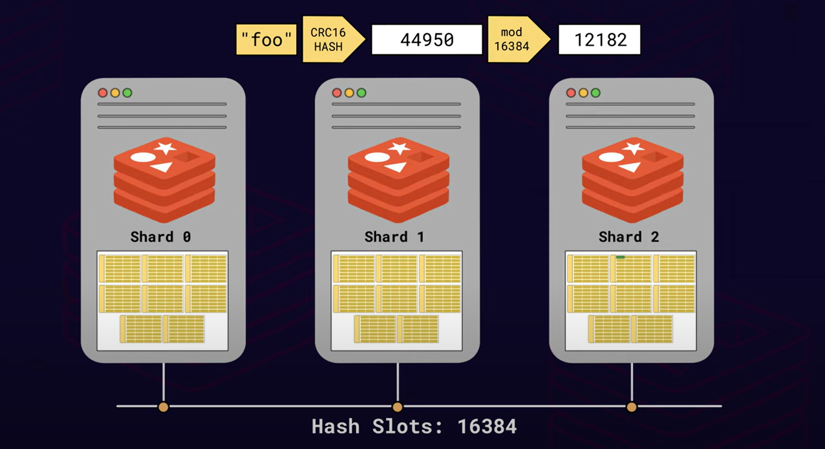
Keys Distribution Model

Slide 27
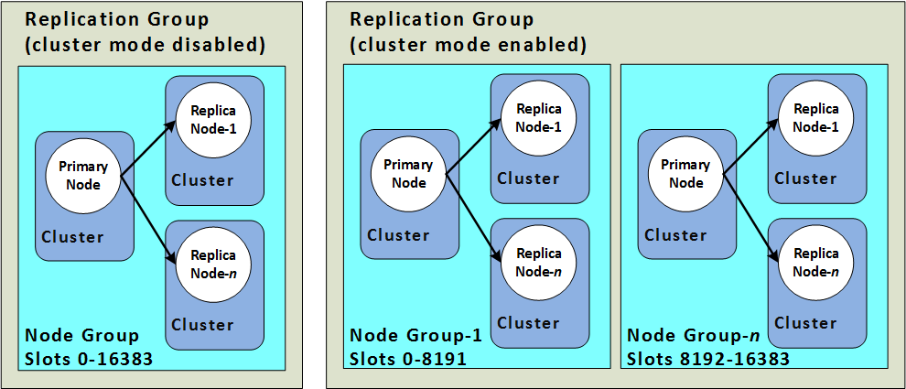

Slide 28
Each node is mapped to a hash slots in total of 16384 hash slots in the nodes (Master-Replica-Replica) using the following formula.
HASH_SLOT = CRC16_HASH(KEY) mod 16384
Eg:
0 to 5460 hash slots in Shard 0
5461 to 10921 hash slots in Shard 1
10921 to 16383 hash slots in Shard 2
Step 1) Calculate CRC16 hash
Hash = CRC16_HASH(“foo”)
Hash = 44950 (example)
Step 2) Mod the hash result by 16384
44950 % 16384 = 12182
Step 3) Map the result into the Shard 2 (As 10921 ≤ 12182 ≤ 16383)

Slide 29
Azure Cache for Redis
Fully managed Redis services hosted on Azure virtual machines.
Upto 99.9% SLA
Secure
Clustering, Replication and Scaling managed by Azure.

Slide 30
Pricing
Azure Redis Cache has 5 pricing tiers –
Basic
Redis instance running on single VM, No SLA and replication.
Standard
Redis instance in a 2 VM configuration (Primary and Replica)
Premium
Redis instances deployed on high performance VM(s) and have lower latencies and better availability and more features.
Enterprise
High performance Redis instances designed by Redis Labs, it offers more availability than premium tier.
Enterprise Flash
Cost effective high performance Redis instances designed by Redis Labs, it reduces overall per-GB memory cost.

Slide 31
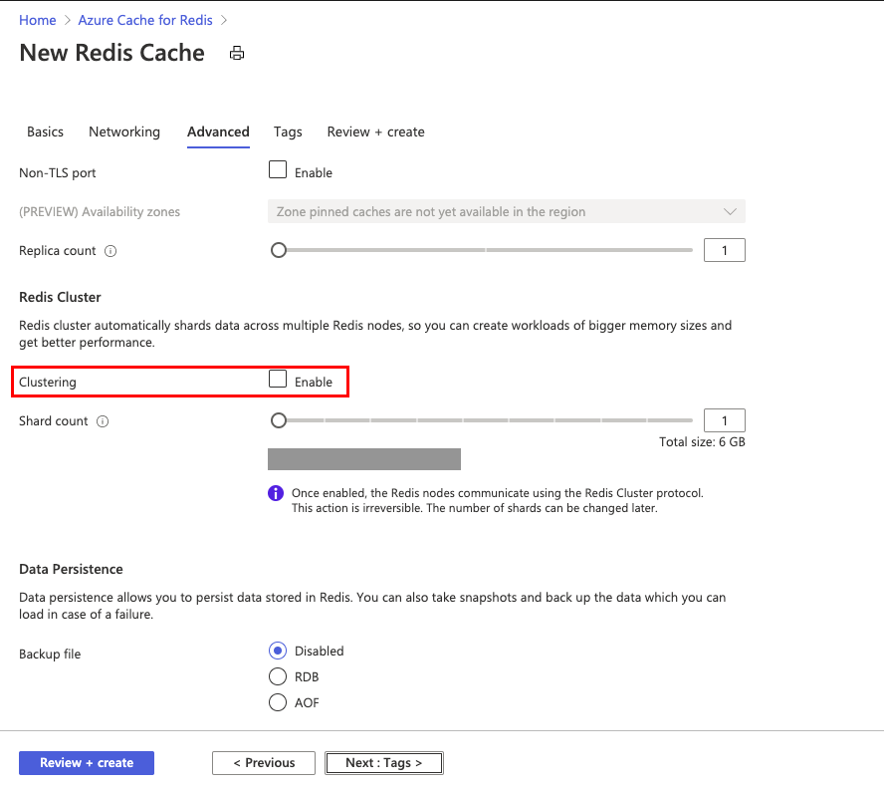
Enable Clustering

Slide 32
Replication
By default, we have 2 VM(s) one as master and another replica.
In case of power outage/network partition, the replica detects it automatically and promotes itself as primary.
Azure Redis Cache gives 3 types of replication strategies –
Standard Replication
Zone Redundancy
Geo Replication
Option | Availability | Standard | Premium | Enterprise
Standard Replication | 99.9% | 🗸 | 🗸 | -
Zone Redundancy | 99.99% | - | 🗸 | 🗸
Geo Replication | 99.999% | - | 🗸 | Preview mode

Slide 33
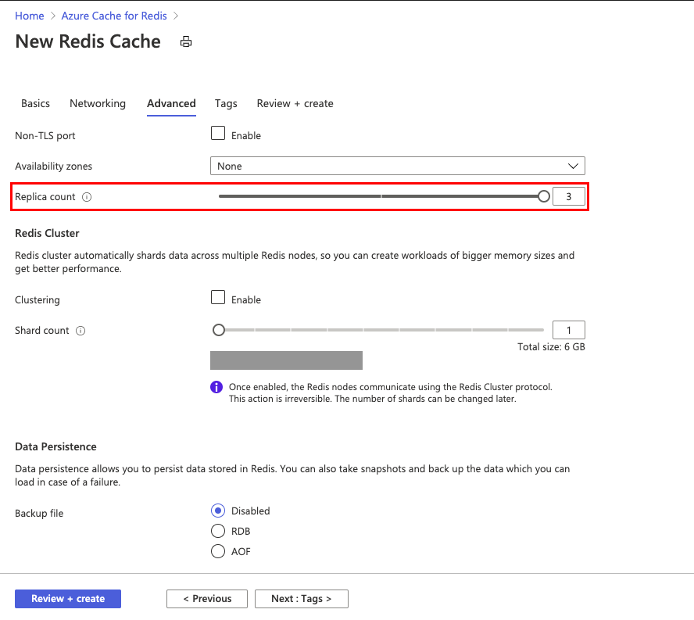
Enable Replication

Slide 34
Scaling
Process
For size upgrade in case of Basic, the Redis instance is shut down completely and data is lost.
For tier upgrade from Basic to Standard the data is retained, Azure provisions two VM(s) acting as primary and replica.
For Standard to Premium tier upgrade, one of the replicas is shut down and reprovisioned to the new size and data synchronization takes place, and this process is continued for all VM(s).
For scaling out in cluster, new shards are provisioned and added to Redis Cluster, the data is re-sharded and hash slots are recalculated.

Slide 35
Scaling TAT
Turnaround time (TAT) depends on the following factors -
Amount of data: Larger amounts of data take a longer time to be replicated
High write requests: Higher number of writes mean more data replicates across nodes or shards
High server load: Higher server load means Redis server is busy and has limited CPU cycles to complete data redistribution.

Slide 36
Data availability
Basic caches are offline while size upgrade.
Basic to Standard tier may receive connection blips.
Standard to Premium is online and functional while scaling and can rarely have connection blips.
Data loss
Basic caches on size upgrade will lose data.
Basic to Standard tier will preserve data.
Standard to Premium will preserve data.
Size downgrade within same tier in case of Standard and Premium will experience data loss based on allkeys-lru eviction policy.

Slide 37
DEMO

